Slide 1

SMART CRIME SCENE EVIDENCES ANALYSIS
Prepared and to be presented by:
Yves MUGABO

Slide 2
OUTLINES
Introduction
Background of the study
Objectives
Problem of the existing system
Solution of the problem
Implementation
Conclusion

Slide 3
INTRODUCTION
We have 5 term:
Smart
Crime
Scene
Evidences
Analysis

Slide 4
Cont.…
Smart: Self-monitoring, analysis and reporting technology.
Several notable types of smart devices are:
smartphones, smart cars, smart doorbells,
smart locks, smart refrigerators, phablets and tablets,
smartwatches, smart bands, smart key chains, smart glasses, and many others.

Slide 5
Cont.…
Crime: an action or omission which constitutes an offence and is punishable by law.
an illegal act for which someone can be punished by the government
Especially :
1: a gross violation of law.
2 : a grave offense especially against morality.
3 : criminal activity efforts to fight crime.
4 : something reprehensible, foolish, or disgraceful
It's a crime to waste good food.

Slide 6
Cont.…
Scene: the place where an incident in real life or fiction occurs or occurred.
a division of an act presenting continuous action in one place. b : a single situation or unit of dialogue in a play the love scene. c : a motion-picture or television episode or sequence

Slide 7
Cont.…
Evidences: the available body of facts or information indicating whether a belief or proposition is true or valid.
This system deals with the Analysis process of Evidences automatically instead of manually. This application will be used for the automatic generation decision report of a certain case suspects and provide final decision

Slide 8
Cont.…
Analysis: detailed examination of the elements or structure of something.
a detailed examination of anything complex in order to understand its nature or to determine its essential features : a thorough study doing a careful analysis of the problem. b : a statement of such an examination. 2 : separation of a whole into its component parts.

Slide 9
BACKGROUND OF THE STUDY
Crime is still the one of most challenges that most governments around the world are struggling with. Families and businessmen are still being directly or indirectly affected by robberies, murder and other many types of crimes.
So, after seeing the RIB existing system takes almost 72 hours to present a primary suspect and sometimes reports comes with errors due to human justice which can be easily diverted in one way or another. This project has been conceived in order to propose a model of analyzing crime evidences in order to facilitate and simplify these actions one of the major tools is to have automated crime scene evidence analysis system which consists of tasks such as registering suspects, revising his/her past criminal report compare it with the evidences and report the summarized report.
Automation is the utilization of technology to replace human with a machine that can perform more quickly and more continuously.

Slide 10
OBJECTIVES
General objective
The general objective of the SMART CRIME SCENE EVIDENCES ANALYSIS
is generally aimed to exclude human-based crime scene evidences analysis which is done manually.
So that this new system is intended to provide better crime registration and better primary suspect reporting system on time and fewer loss of time due to fast suspect evidences analysis using information technology.

Slide 11
Specific objective
Below are specific objectives of the new system:
Reduce the manual work for managing suspects
Improved notification between RIB Station and case reporter
Reducing the manual work for arranging offices to cases
Reduce time spent waiting for the suspect decision report
help RIB Station commander to allocate Station officer to a specific case and where they can sit during exam period
Reduce large manpower that was required
Improved case management during the process to find primary suspect

Slide 12
PROBLEM OF THE EXISTING SYSTEM
As our world is moving very faster,
especially my country in technology we are trying to move from traditional system to digital system very faster. The current system as it is paper based system.
There are some issues caused by this manual system below:
Injustice due to poor of following up criminal.
Time consuming
Errors in reporting.
Needs manual calculations.

Slide 13
SOLUTION TO THE PROBLEMS STATES
Minimum time required (48 hours)
User friendliness and interactive
Better service
Human judgement will be turned to Automation with the use of Evidences analysis.
All case reporters will be able to know which status and where they can ask more information about their case instead of coming at RIB Station to see where their case details they will be notified on their phone.

Slide 14
IMPLEMENTATION

Slide 15
CONCLUSION
To conclude, we are in a world where technology is advanced and we need more innovative actions to accelerate this modernity to a highly productive one With this system being developed, I hope to reduce time wasting, avoid misunderstandings, and provide easy data flow and less hard work. I believe that the pertinent departments, such as RIB stations, Rwanda National Police will find this system highly convenient and reliable in order to accomplish their goals
Our hope is that this software SMART CRIME SCENE EVIDENCE ANALYSIS SYSTEM to improve their performance in activity of primary suspect delivery based on the crime evidences, and we hope that the use of this software will enhance the Service of evidence analysis and decision making.

Slide 16
Cont.…
With no doubt, the output of the SMART CRIME SCENE EVIDENCES ANALYSES reduces the injustice, workload on suspects as well as Case officers. It benefits all the educational institutes by reducing the complexity involved while allocating the exam duty for the staff, examination rooms and seats for the students.

Slide 17
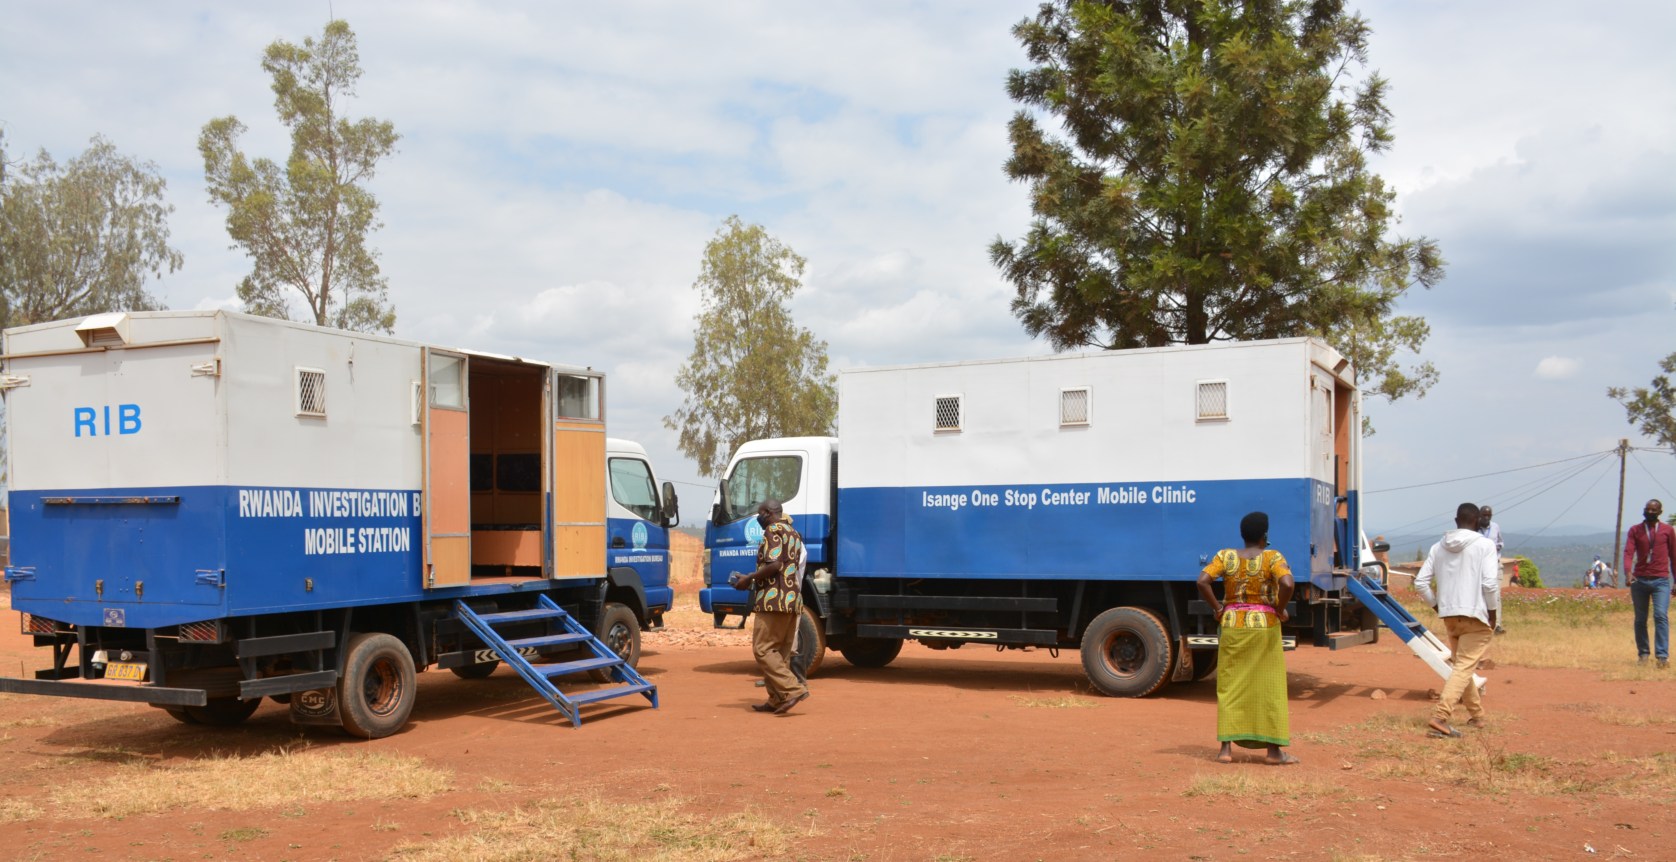
God bless you all..!

